Slide 1
Disaster recovery plan – Analysis
The aim of disaster recovery is to keep business operations active , In case of any damage or hazard occurs.
This could be hardware or software failure, a network outage, a power outage, physical damage to a building like fire or flooding, human error, or some other significant disaster.
Disaster recovery helps in restoring applications, data, and hardware quickly for business continuity.
Following are the steps considered while designing a DR plan with AWS:
Ship your EBS Volumes to Another AZ/Region.
Utilize Multi-AZ for EC2 and RDS.
Copy your S3 Data to Another Region.
Backup your data.
Prioritize costs.
Choose the right backup strategy.
Notes:
Today we’ll review some aspects about the AppScan Tool, the project and our goal as Dev Sec Ops Team

Slide 2
Advantages of having a DR Plan:
Data and hardware will be protected.
Decreases downtime, increases productivity.
Helps in maintaining your business continuity.
Providing a standard for testing the plan.
Providing a sense of security by minimizing delays and protecting data.
Notes:
Today we’ll review some aspects about the AppScan Tool, the project and our goal as Dev Sec Ops Team

Slide 3
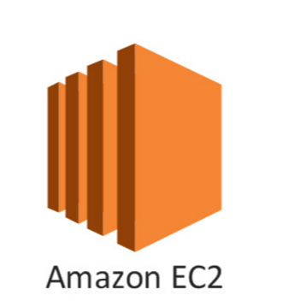



S3_Backup
EC2_Backup
EBS
Bucket
AMI
Cross-Region replication (CRR) is used to copy objects across Amazon S3 buckets in different AWS Regions. AWS Region1 Region2
US East
(N. Virginia)
CRR
US West
(N. California)
Source
Destination
Notes:
Today we’ll review some aspects about the AppScan Tool, the project and our goal as Dev Sec Ops Team

Slide 4






Architecture
+Additional
Services
Bucket
Cloud Formation
Bucket
Cloud Formation
Lambda
Replication
Lambda
Import and Export
Import and Export
DB
DB
Route53
+Additional
Services
Route53
User
Notes:
Today we’ll review some aspects about the AppScan Tool, the project and our goal as Dev Sec Ops Team

Slide 5
Cost
Instance storage Cost AR-D
Proxy server 200GB 135$ 160$
DB server 200GB 35$ 75$ (M-AZ)
Data transfer EBS 16$/M
Elastic IP 0.12$ if not attached
DB Transfer 15$/M
S3_Storage
Buckets Bucket Size Number of Objects Cost CRR_Cost
From-usaa 11.2TB 16.1k 264$ 552$
From-bfs 317.7GB (S)+381.0GB(SIA) 3.5K 13$ 30$
ar-output 34.7 TB 2.4M 830$ 2014$
Notes:
Today we’ll review some aspects about the AppScan Tool, the project and our goal as Dev Sec Ops Team

Slide 6
Cost:
Instance storage Cost AR-D
Proxy server 200GB 135$ 160$
DB server 200GB 35$ 75$ (M-AZ)
Data transfer EBS 16$/M
Elastic IP 0.12$ if not attached
DB Transfer 15$/M
S3_Storage
Buckets Bucket Size Number of Objects Cost CRR_Cost
From-usaa 11.2TB 16.1k 264$ 552$
From-bfs 317.7GB (S)+381.0GB(SIA) 3.5K 13$ 30$
ar-output 34.7 TB 2.4M 830$ 2014$
Notes:
Today we’ll review some aspects about the AppScan Tool, the project and our goal as Dev Sec Ops Team

Slide 7

Questions?

